Slide 2


Modeling Risk Cluster Based on Sentiment Analysis in Bahasa Indonesia for SME Business Risk Analysis Documents
Presented by:
Irfan Wahyudin (G651130734)
Supervised by:
Dr. Eng. Taufik Djatna, S.Tp, M.Si
Dr. Eng. Wisnu Ananta Kusuma, ST, MT
Department of Computer Science , Faculty of Mathematics and Natural Science
Bogor Agricultural University
Notes:
Assalamualaikum Wr Wb.
Good morning, ladies and gentlements, today I have an opportunity to deliver my presentation entitled Modeling Risk Cluster Based on Sentiment Analysis for SME Business Risk Analysis Documents, supervised by Dr Taufik Djatna from Dept. of Agroindustry Engineering and Dr Wisnu A Kusuma from Dept. of Computer Science

Slide 3
Outline
Literature Review
Risk Clustering
Sentiment Analysis
Techniques
Introduction
Motivation
Problems
Objectives
Benefits
Method
Risk Clustering
Risk Measurement
Evaluation
Conclusion
Conclusion
Future Works
Discussion
Main Result
Advantages and Disadvantages

Slide 4
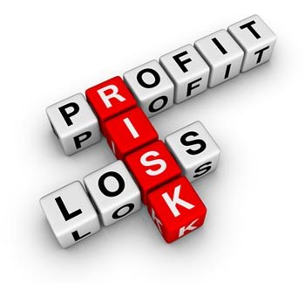

Introduction
Definition
Source:
Newey (2014)

Slide 5


Introduction
Motivation
Current Condition
The goverment encouraged the national bank to provide financing SME Business
To mitigate risk, the central bank asked the corresponding bank to have risk management
Evaluate the performance of a bank through its Non Performing Loan (NPL) ratio
Notes:
There are 55 millions of Small Medium Enterprise business running in Indonesia as of 2013, and we believe this number is still increasing as there is no economical crisis in Indonesia.
Therefore, the government encouraged the national bank to provide financing and to mitigate the risk central bank asked the corresponding bank to have the risk management.
And as a respond, the corresponding bank forms risk mgmt division to analyze every proposal submitted by the customers

Slide 6
Introduction
Motivation
Current Condition
Risk Analysis Based on 5Cs Credit
(Capital, Condition, Collateral, Capacity, Character)
Quantitative
Measure Financial Quality
Qualitative
Analyst gives opinion and mitigation upon the risk that might occure
Credit score as an output
Naratively written risk opinion as an output
Popular, widely used
Not so popular
Objective
Not computerized
Computerized (Loan Originating System)
Subjective
Case study: Standard Operational and Procedure of SME FInancing
(Gumparthi 2010;Soares et al 2011)

Slide 7
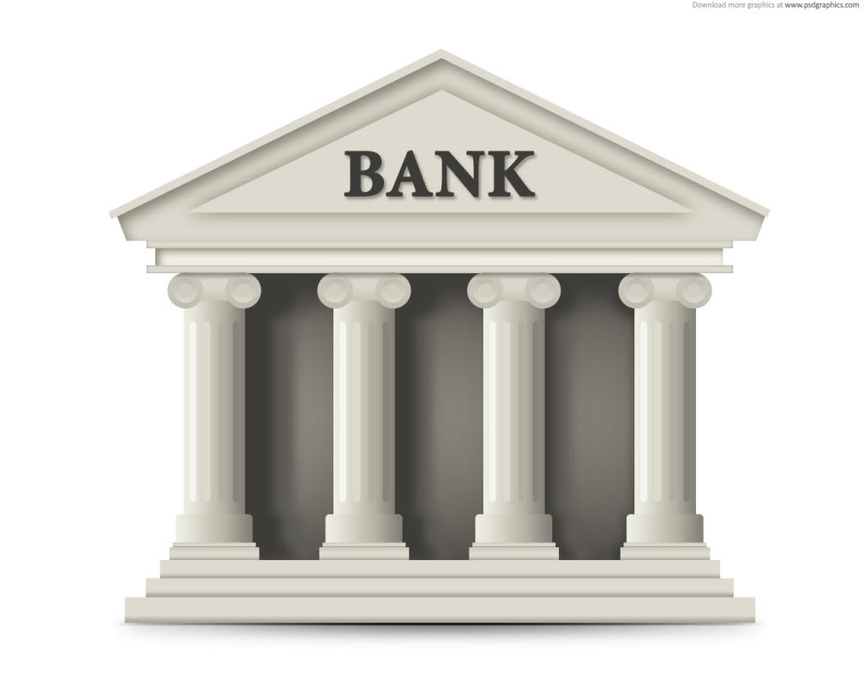




Introduction
Motivation
Problems
2012: 2,01 %
2013: 2,26 %
2014: 2,xx %
SME Business
Quantitative Model
LOS and Credit Scoring
Qualitative Model
Risk Opinion
Opinion → Sentiment
Notes:
We conducted this research to a national bank where SME financing is one of its business pillar. I’m afraid, due to the bank policy, we are not allowed to mention the bank name in this research, we are only allowed to deliver our result in this research.
But the problem is, the banks Non Performing Loan Ratio for has above the target. For three consecutive years they achieved NPL ratio 2. for 2012, 2. for 2013, and 2. for 2014. Through his speech in welcoming 2015 new year, the CEO encourage the risk management to have better risk analysis and mitigation towards the financing proposal.
Risk analysis in this bank is done by implementing two model, namely quantitative model and qualitative model.The existance of opinion in the risk documents, gave us an idea to process the opinion as an sentiment, so we can conduct the sentiment analysis

Slide 8

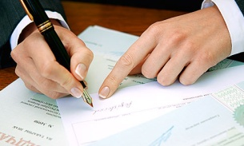

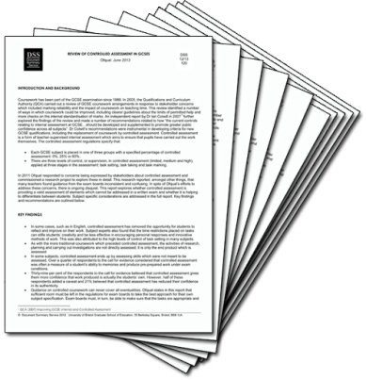



Introduction
SME Financing Flow
Proposal Registration
Bank Indonesia
Checking
Manager
Approval
Credit Scoring
(by Credit Analyst)
Approved?
Yes
Risk
Analysis
Documents
Risk
Analysis
Documents
Risk and Compliance Analysis
Decision
Making
Risk and Compliance Analysis
No
Notes:
Here we show you the standard operation and procedure (SOP) regarding to credit proposal processing. What i want to show you that the object of our observation is highlighted inside the red rectangle.
There is a process called as Risk and Compliance analysis. The output this process is risk analysis documents that consist of opinions from the risk analysts regarding to the risk that might occur when the loan facility is given to the customers, and these opinions later to be used as a consideration by the decision makers to make a decision. These opinions are written naratively, so we think that it is possible to conduct the sentiment analysis through theses documents.

Slide 9
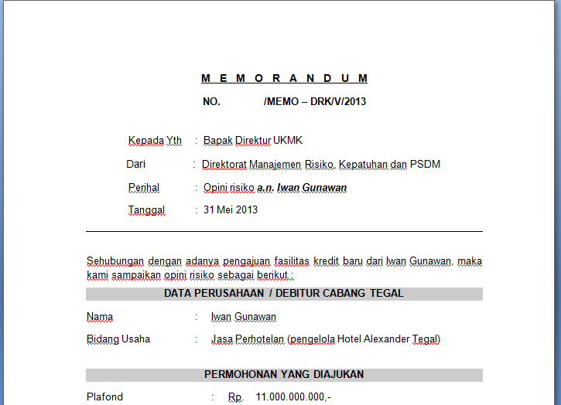
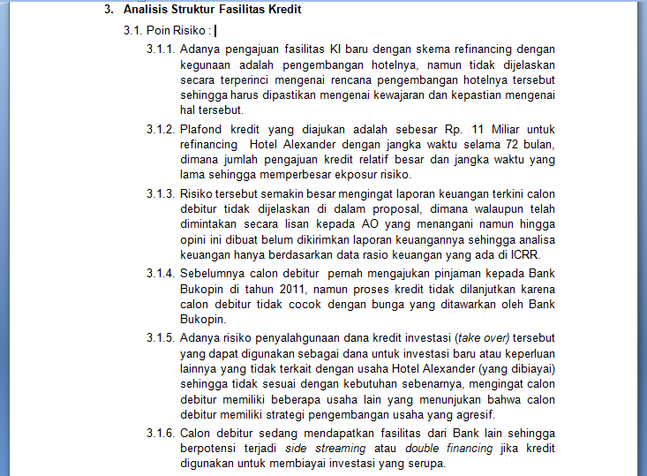
Introduction
Risk Analysis Documents
7 Things to Analyze:
ICRR
Financial Performance
Proposed Loan Facility
Business Performance
Repayment Ability and Cash Flow
Legal Analysis
Foreign Exchange Analysis (Optional)

Slide 10
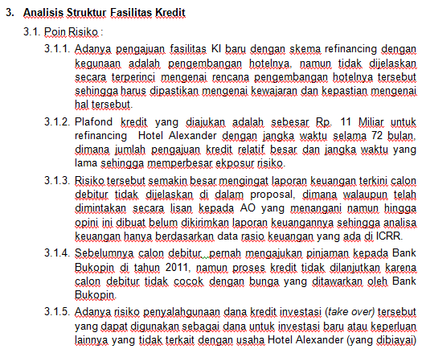
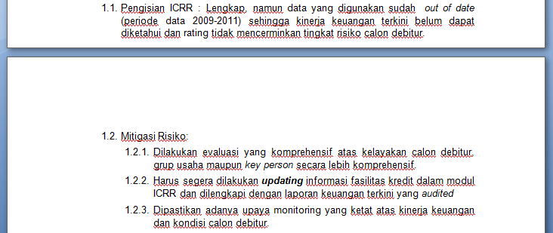
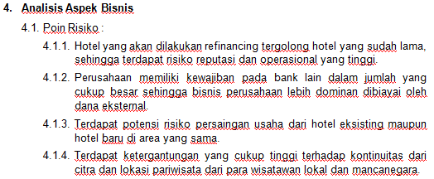
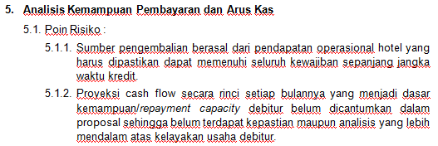
Introduction
Risk Analysis Documents
Risk Opinion

Slide 11

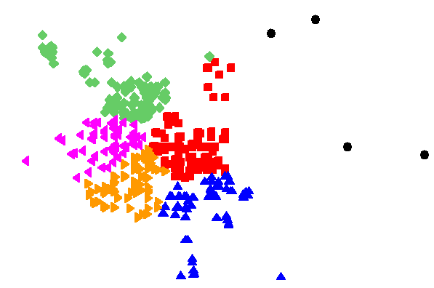
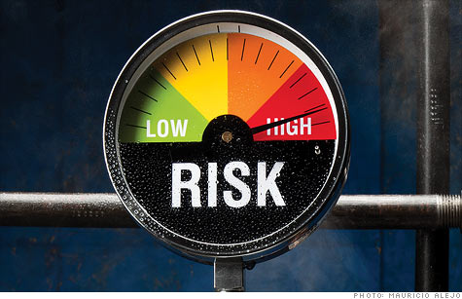
Introduction
Motivation
Problems
How to conduct sentiment analysis for SME Business?
What is the appropriate model?
How to quantify risk?
Notes:
How to gather more valuable risk knowledge to help the bank to mitigate the risk, and furthermore decrease the NPL ratio?
By exploring the knowledge within the risk opinion documents
What is the appropriate model that represent the business risk from the risk opinion document?
Since there is no classified documents yet that can be used as training data, the appropriate model is unsupervised learning (perform clustering task)
How to quantify the risk opinion made by the analyst(s)?
By performing sentiment analysis to quantify the opinion polarity (positivity/negativity)

Slide 12
Introduction
Objectives
A. Perform clustering task to group the risk analysis documents
B. Measure the risk level in each cluster using term-importance and sentiment weighting
C. Evaluate clustering task and sentiment measurement to reveal the implication with the criteria in assessing the loan risk

Slide 13



Introduction
Benefits
To enhance Standard Operation and Procedure in SME Financing
Retrieve information from Risk Analysis Documents
Provide a model to support the decision making

Slide 14
Introduction
Boundaries
The retrieved documents are limited to loan proposal with filing value >= 5 Billion Rupiah
There is no approval criteria yet
The risk analysis limited to 2013 to early 2014

Slide 15
Outline
Literature Review
Risk Clustering
Sentiment Analysis
Techniques
Introduction
Motivation
Problems
Objectives
Benefits

Slide 16
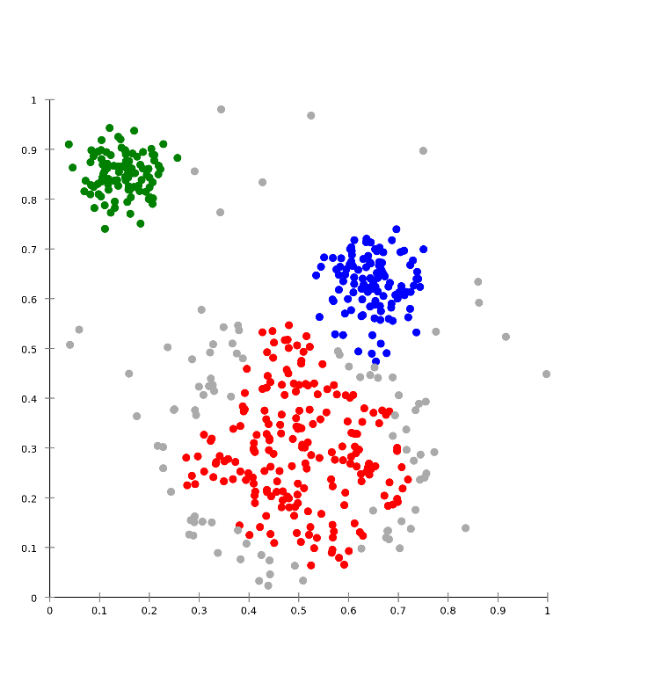

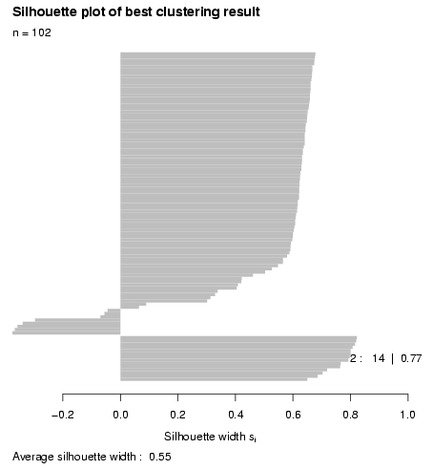
Literature Review
Techniques
Clustering
K-Means (Mac Queen 1967)
Pillar Algorithm (Barakbah 2009)
Silhouette Function (Rosseuw 1986)

Slide 17


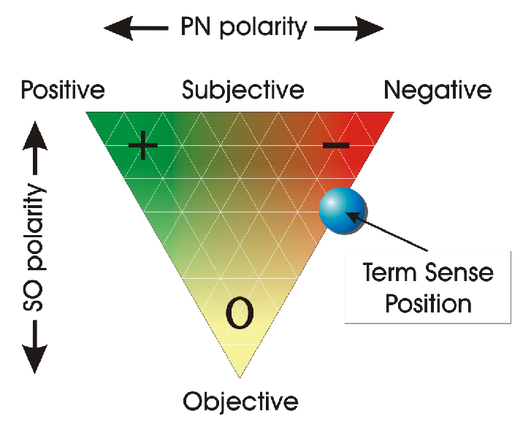
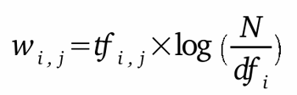
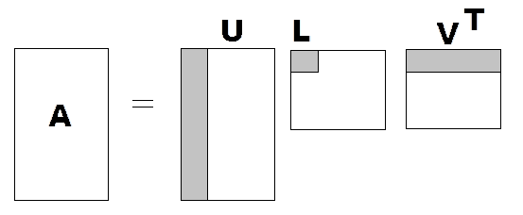
Literature Review
Techniques
Sentiment Analysis
Sentiment Analysis in Bahasa Indonesia (Lunando and Purwarianti 2013)
SentiWordNet (Esuli and Sebastiani 2006)
TF-IDF (Manning 2009)
Singular Value Decomposition (Osinski 2004; Zhang and Dong 2004; Thomo 2015)

Slide 18
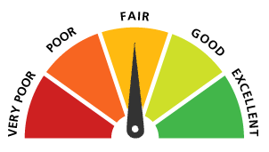
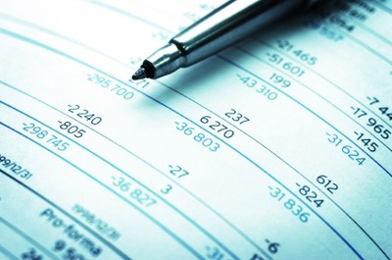
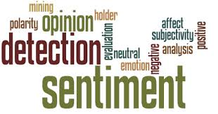

Literature Review
Risk Clustering
Detect bankcruptcy,
Credit & default scoring (Kou et al. 2014)
Financial & numerical data
Instead of,
Utilize

Slide 19
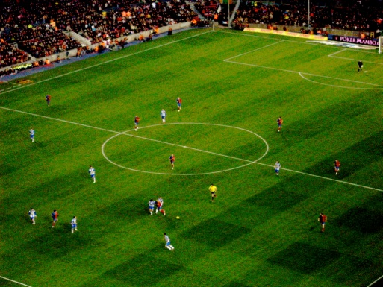
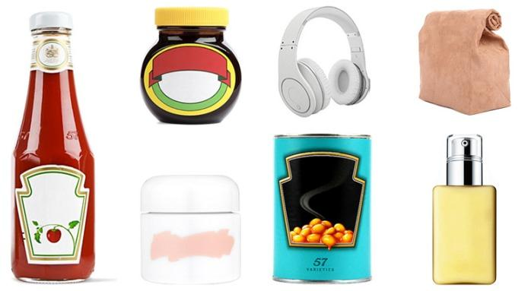

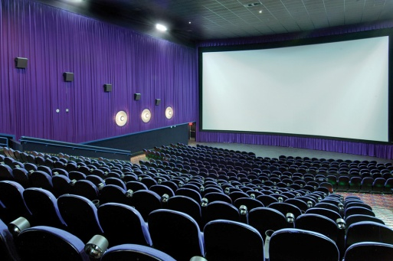


Literature Review
Sentiment Analysis
Machine Learning
Lexicon
(Medhat et al 2014)
(Esuli and Sebastiani 2006)
(Thelwall et al 2010)
Notes:
Let’s enter the first part which is a brief introduction about the background of our research.
First of all, I would like to tell you about sentiment analysis…We have to admit that social media such as facebook and twitter have become a part of our lifestyle. I believe that most of everyone of you in this room at least has one social media account.
Through social media, people are tend to share information about their current feeling like being happy or sad, their current activity like watching a football match, watching a movie, reflect their political view during election campaign, until about their usage upon a product.
But there is more than just sharing activities, people are motivated to express their thought, opinion or sentiment about their activities. Therefore other people who read their status or tweet could understand the tendencies of their thougth, wether it is good or bad.
This motivated researcher to conduct a new research which is called as Sentiment Analysis.

Slide 20
Outline
Method
Risk Clustering
Risk Measurement
Evaluation
Introduction
Motivation
Problems
Objectives
Benefits
Literature Review
Risk Clustering
Sentiment Analysis
Techniques

Slide 21
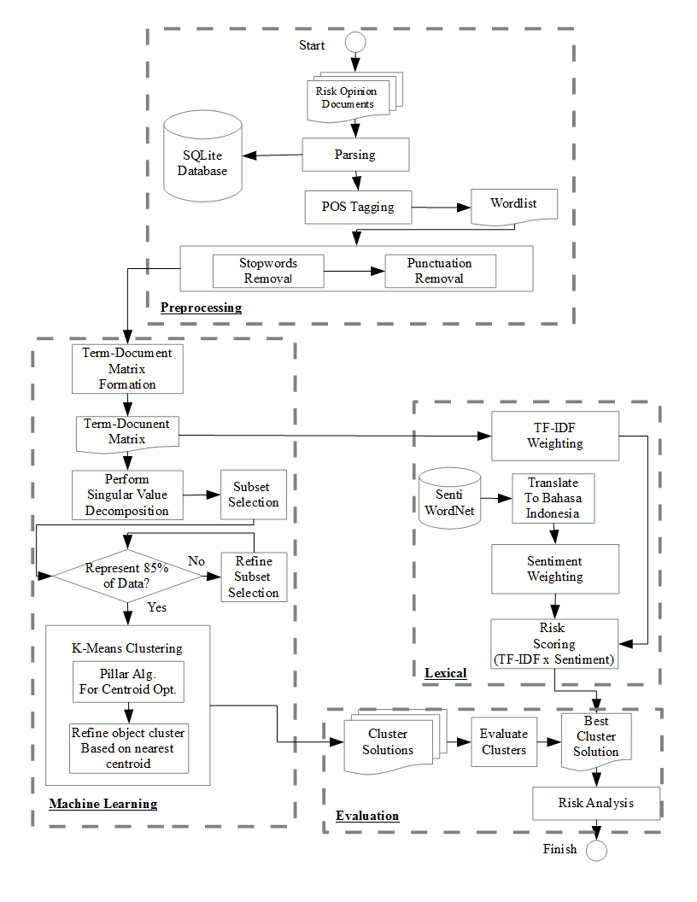
Methodology
Framework
The Big Picture
1. Preprocessing:
Prepare and cleaning up the data
2. Risk Clustering:
Build the cluster model
3. Risk Measurement:
Measure the
Sentiment
Polarity & weight
4. Evaluation:
Risk Analysis
Notes:
There are four major steps that we conduct in this research. The first one is Preprocessing, is performed to clean up the unnecessary data and select only the data that enable us to gather valuable information.
Second is Machine learning, here we performed dimension reduction to suppress the feature that will be used in K-Means clustering. The third one is lexical method, here we measure each risk in each cluster by using Sentiwordnet, a sentiment polarity database.
And the last one is conducting evaluation to evaluate the result in each previous process.

Slide 22
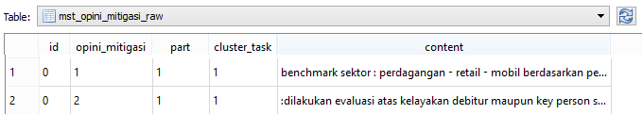
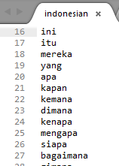
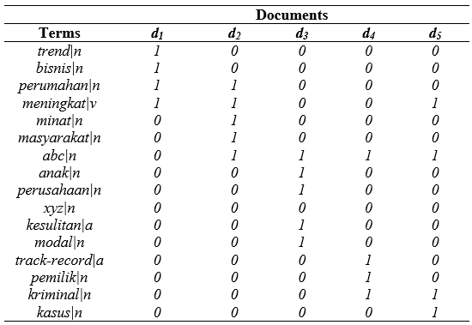
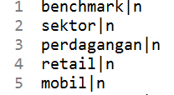
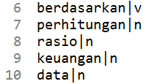
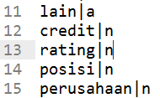
Preprocessing
Parsing
Stopwords
Removal
Term-Document
Matrix
POS Tag

Slide 23
Clustering (Dataset Preparation)
 | d1 | d2 | d3 | d4… | d519
usaha | 1 | 1 | 0 | 0 | 1
risiko | 0 | 0 | 1 | 0 | 1
berkembang | 1 | 1 | 1 | 1 | 0
menurun | 1 | 0 | 0 | 1 | 1
modal | 0 | 0 | 1 | 0 | 0
Aim:
→ To reduce the term-document matrix dimension based on its term concept
Terms
(3290)
3290 x 3290
Term
Concept
High dimension
Term-document dataset
(3290 x 519)
Characteristic
Roots
Pick subsets that represent entire dataset
519x519
Low dim.
dataset
(519x 300)
Document
Concept

Slide 24
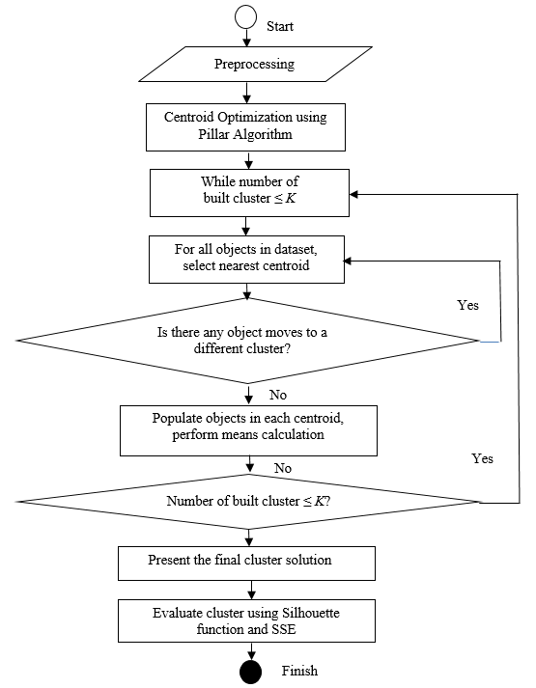
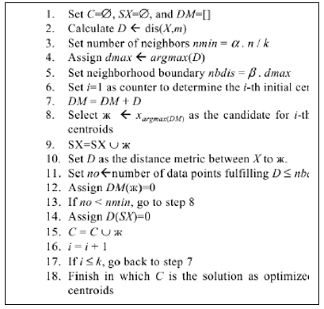
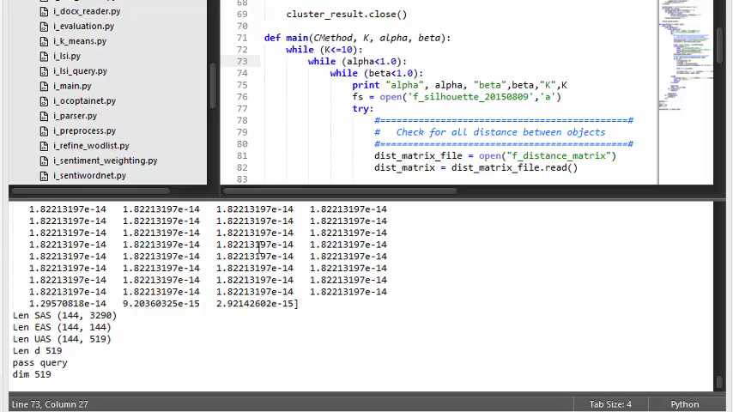
Clustering (Objective 1)
Notes:
After the preprocessing is done. We found that there are 3290 terms, that can be used for further process. Since we obtain a high dimensional term-document vector that is 519 by 3290. We consider to perform dimension reduction by implementing Support Vector Decomposition that is a technique for reduce dimension and concept extraction.
Basically, SVD divide the origin of term-document matrix into three parts, the first part contain the term concept, in our case it is in the form of 3290 x 3290 matrix that represent the concept extracted from the term in the risk corpus.
The second part is the characteristic roots matrix, or if u familiar with eigen vector this second part is the eigen vector of the term-document matrix.
Third part is document concept, and since we want to obtain the concept within the document, thus, we use this object as a feature for the next step that is clustering.

Slide 25
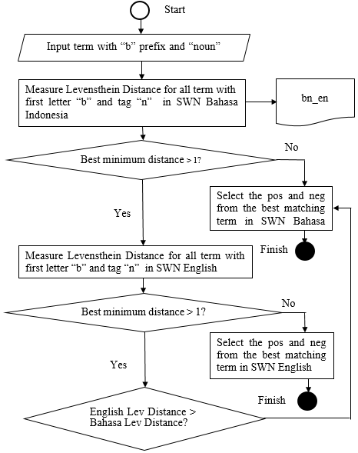
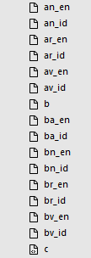
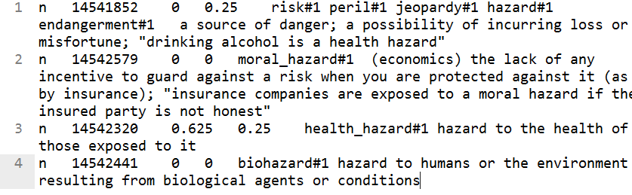
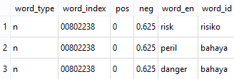
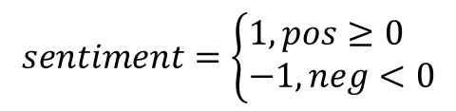
Sentiment Measure (Objective 2)
(Lunando and Purwarianti 2013;
Denecke 2008)
$$sentiment=\left\{\begin{aligned}&1, pos≥0 \\ &−1, neg<0\end{aligned}\right.$$

Slide 26
Outline
Discussion
Main Result
Advantages and Disadvantages
Introduction
Motivation
Problems
Objectives
Benefits
Literature Review
Risk Clustering
Sentiment Analysis
Techniques
Method
Risk Clustering
Risk Measurement
Evaluation

Slide 27
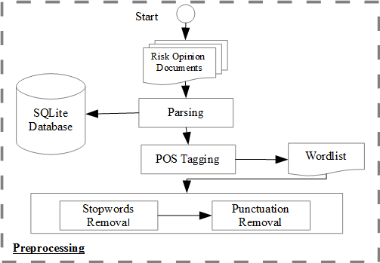
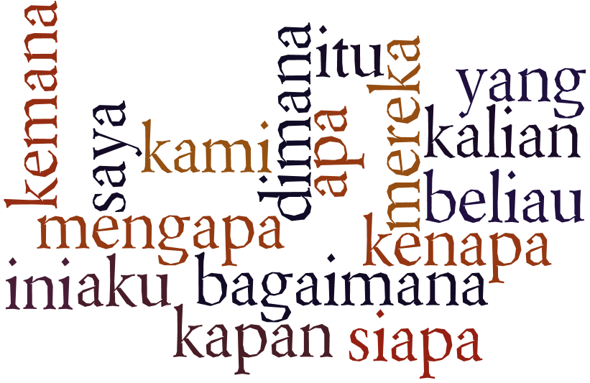
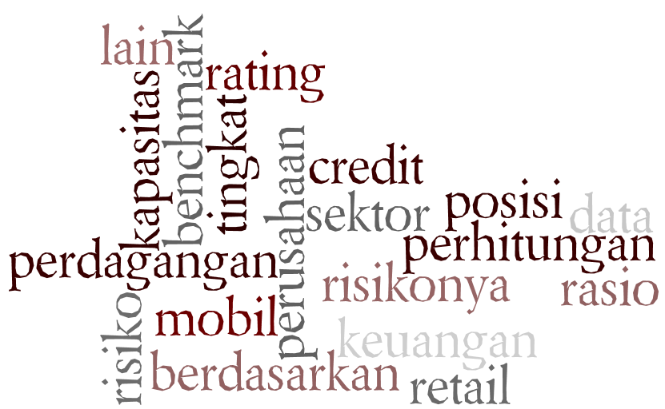
Methodology
Preprocess
Stopwords Removal
Objective #1: Perform Prerequisite for Clustering Task
→Aim: To have valuable data by eliminating unnecessary data
(Manning 2009)
→ We use a list as a baseline in removing stopwords and punctuation
REMOVE
1. Preprocessing:
Prepare and cleaning up the data
2. Risk Clustering:
Build the cluster model
3. Risk Measuring:
Measure the
Sentiment
Polarity & weight
4. Evaluation:
Risk Analysis
KEEP
Notes:
Lets take a look deeper in each process. In preprocess, we did stopwords removal which is a task to remove any terms that unnecessarily affected the process and information. There are many version of stopwords over the internet, all of them are intended to specific task. Since the terms and sentence that be used in the risk documents are already in formal terms we look forward the formal stopwords list that developed by Peb Ruswana, he developed the stopwordlist based on a research NLP for Bahasa Indonesia

Slide 28
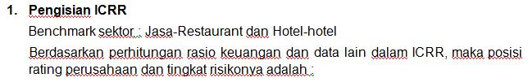

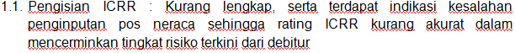
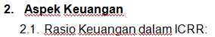
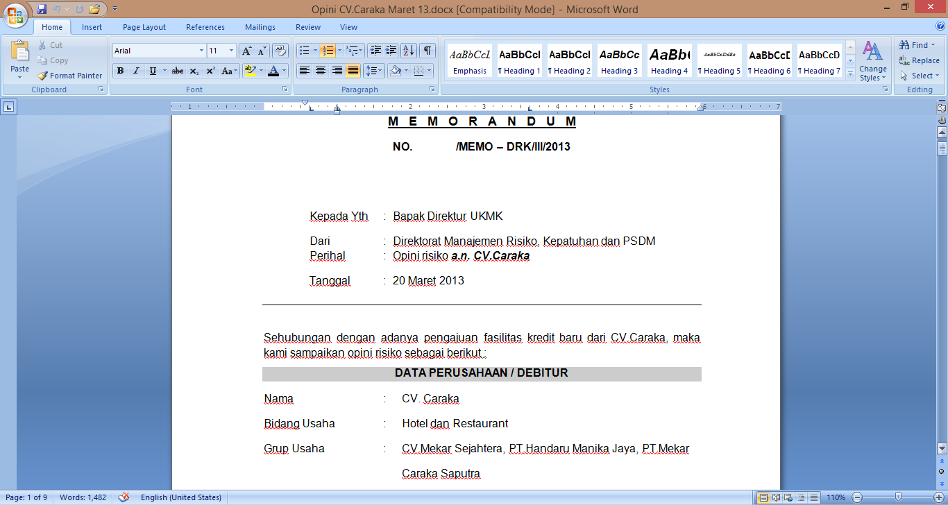
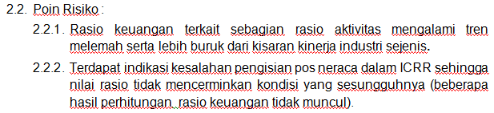
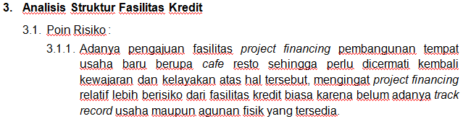
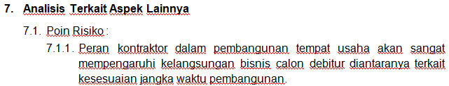

pREPROCESSING
Raw Documents
(MS Word format)
Parse and Import
To SQLite DB

Slide 29
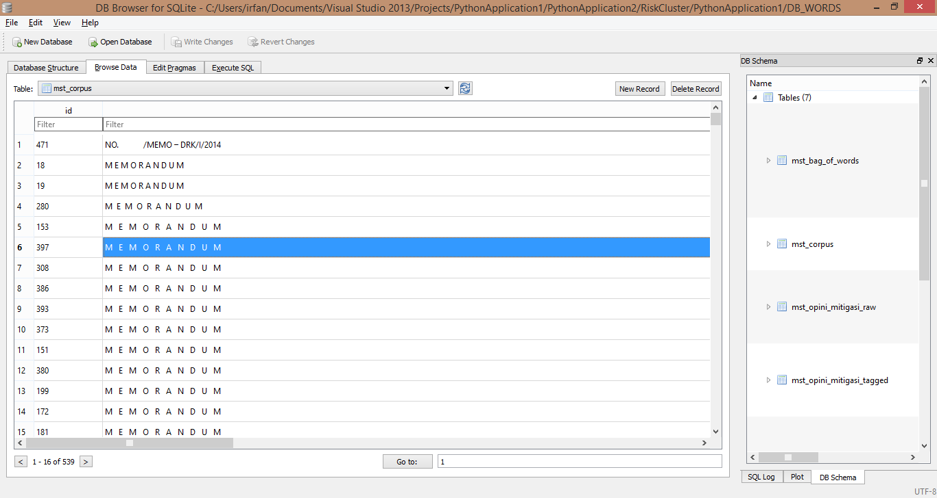
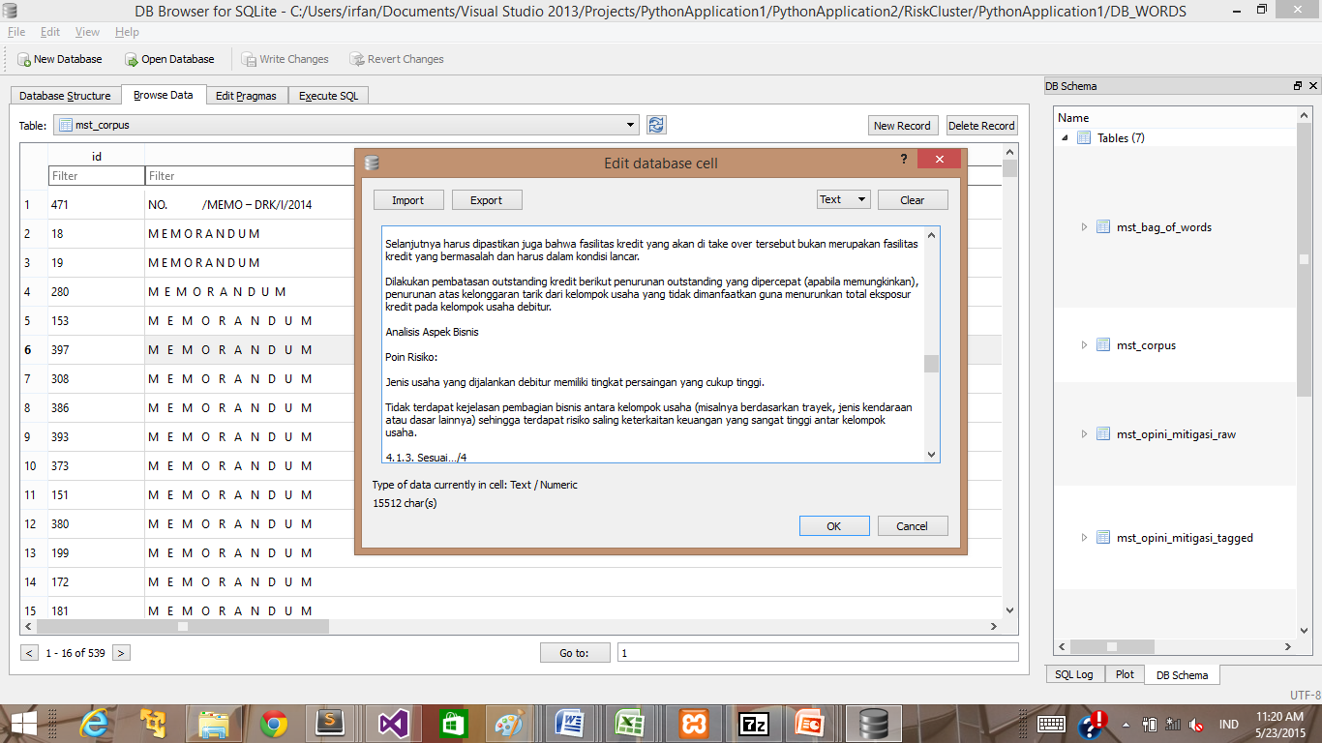


pREPROCESSING
Query and parse the terms, remove stopwords
TF-IDF x Sentiment Scoring

Slide 30



Methodology
Risk Clustering
K-Means
Answering the First Problem
High dim.
Dataset
(3290 x 519)
 | d1 | d2 | d3 | d4… | d519
usaha | 1 | 1 | 0 | 0 | 1
risiko | 0 | 0 | 1 | 0 | 1
berkembang | 1 | 1 | 1 | 1 | 0
menurun | 1 | 0 | 0 | 1 | 1
modal | 0 | 0 | 1 | 0 | 0
SVD = Matrix Factorization for Dimension Reduction
Low dim.
dataset
(519 x 300)
1. Preprocessing:
Prepare and cleaning up the data
2. Risk Clustering:
Build the cluster model
3. Risk Measuring:
Measure the
Sentiment
Polarity & weight
K-Means is…
Old but still effective and popular to be used as partitioning method
Classic challenge to break:
Centroid initialization
How much partition (K) is optimal for Risk Cluster?
Solution: Pillar Algorithm
4. Evaluation:
Risk Analysis
μ
Notes:
After we select the subset from the entire term-document vector we perform the k-means clustering…Although we already suppress the term-document vector, in fact, by performing the original K-Means scheme with randomized centroid initialization, it tooks a long execution time.
Therefore we have to solve some classic challenge:
How to optimize the centroid initialization
How much partition or cluster or K is optimal for the develop risk cluster

Slide 31

Methodology
Machine Learning
K-Means
Pillar Algorithm
Building’s Pillar-Inspired Algorithm
To get the best centroids
(Barakbah 2009)
μ
Rules to get best centroids:
Fulfill α, minimum number of nearest neigbors, let say 3
2. Fulfill β, maximum distance of neighbors, let say 5 (in vector unit)
Notes:
For the first challenge we look forward for some centroid initialization algorithm. And we found one that seems promising to be used to this research. That algorithm is Pillar algorithm.
Basically the algorithm is to find the objects with the furthest distance from the mean value of all objects. SO as you can see in the screen it explores all objects as a candidate of centroid and scans the number of neighbors based on rule given.
The rule is:
The object candidate must have at least alpha number of neighbor in radius of beta

Slide 32

Methodology
Risk Measurement
Weighting
TF-IDF
Answering the Second Problem
Objective #2: Measure The Risk Level
To get the terms weight in each cluster, we combine term importance weighting and sentiment weighting
For term importance weighting we use Term Frequency, Inverse Document Frequency (TF-IDF):
1. Preprocessing:
Prepare and cleaning up the data
2. Risk Clustering:
Build the cluster model
“Benchmark sektor : Perdagangan - Retail - Mobil
Berdasarkan perhitungan rasio keuangan dan data lain dalam ICRR, maka posisi rating perusahaan dan tingkat risikonya adalah…”
Cluster | Doc | benchmark |n | sektor |n | perdagangan |n | retail |n | mobil |n | perhitungan |n | rasio |n | keuangan |n
3 | d1 | 1.563 | 3.865 | 1.563 | 1.563 | 1.563 | 1.563 | 1.563 | 2.779
3 | d2 | 1.081 | 0.347 | 0.000 | 0.000 | 0.000 | 0.000 | 1.290 | 1.290
2 | d3 | 1.718 | 2.162 | 0.000 | 0.000 | 0.000 | 0.695 | 2.579 | 2.579
2 | d4 | 0.973 | 0.556 | 0.313 | 0.000 | 0.000 | 0.313 | 1.975 | 1.669
1 | d5 | 1.288 | 0.926 | 0.926 | 0.521 | 0.521 | 0.521 | 2.230 | 1.622
 | .
 | .
 | .
1 | d9 | 1.946 | 1.546 | 1.112 | 0.625 | 1.112 | 0.625 | 3.949 | 1.946
2 | d10 | 2.110 | 1.405 | 0.000 | 0.000 | 0.000 | 0.568 | 2.740 | 2.433
3. Risk Measuring
Measure the
Sentiment
Polarity & weight
4. Evaluation:
Risk Analysis
Notes:
After conducting K-Means clustering, we perform term weighting to measure the risk level in each cluster. There are two method that be used in term weighting, the first one is TF-IDF. By performing TF-IDF we can define the value of each terms based on its importance.
For instance, in cluster three, document number one, there is sentence like this Benchmark…. So by calculate TF-IDF, each term has their own value indicating their importance.

Slide 33





Methodology
Risk Measurement
Weighting
Sentiment Weighting
Doc Terms | POS | SWN Terms English | SWN Terms Bahasa | Lev. Distance | Pos | Neg | Sentiment Score
benchmark | n | benchmark | benchmark | 0 | 0.0625 | 0.0625 | 1
sektor | n | sector | sektor | 0 | 0 | 0 | 1
perdagangan | n | trade | perdagangan | 0 | 0.0114 | 0 | 1
retail | n | retail | eceran | 0 | 0 | 0 | 1
mobil | n | car | mobil | 0 | 0 | 0 | 1
risiko | a | risk | berdasarkan | 0 | 0 | 0.071428571 | -1
perhitungan | n | calculation | perhitungan | 0 | 0.0104 | 0 | 1
rasio | n | ratio | perbandingan | 1 | 0 | 0 | 1
keuangan | n | finance | keuangan | 0 | 0 | 0 | 1
English
 | benchmark |n | sektor |n | perdagangan |n | retail |n | risiko |a | perhitungan |n | rasio |n | keuangan |n
d1 | 1.563 | 3.865 | 1.563 | 1.563 | 1.563 | 1.563 | 1.563 | 2.779
d2 | 1.081 | 0.347 | 0.000 | 0.000 | 0.000 | 0.000 | 1.290 | 1.290
d3 | 1.718 | 2.162 | 0.000 | 0.000 | 0.000 | 0.695 | 2.579 | 2.579
d4 | 0.973 | 0.556 | 0.313 | 0.000 | 0.000 | 0.313 | 1.975 | 1.669
d5 | 1.288 | 0.926 | 0.926 | 0.521 | 0.521 | 0.521 | 2.230 | 1.622
.
.
.
d9 | 1.946 | 1.546 | 1.112 | 0.625 | 1.112 | 0.625 | 3.949 | 1.946
d10 | 2.110 | 1.405 | 0.000 | 0.000 | 0.000 | 0.568 | 2.740 | 2.433
 | benchmark |n | sektor |n | perdagangan |n | retail |n | risiko |a | perhitungan |n | rasio |n | keuangan |n
d1 | 1.563 | 3.865 | 1.563 | 1.563 | -1.563 | 1.563 | 1.563 | 2.779
d2 | 1.081 | 0.347 | 0.000 | 0.000 | 0.000 | 0.000 | 1.290 | 1.290
d3 | 1.718 | 2.162 | 0.000 | 0.000 | 0.000 | 0.695 | 2.579 | 2.579
d4 | 0.973 | 0.556 | 0.313 | 0.000 | 0.000 | 0.313 | 1.975 | 1.669
d5 | 1.288 | 0.926 | 0.926 | 0.521 | -0.521 | 0.521 | 2.230 | 1.622
.
.
.
d9 | 1.946 | 1.546 | 1.112 | 0.625 | -1.112 | 0.625 | 3.949 | 1.946
d10 | 2.110 | 1.405 | 0.000 | 0.000 | 0.000 | 0.568 | 2.740 | 2.433
Bahasa Indonesia
(Lunando and Purwarianti 2013)
Note! Not all terms correctly found in SentiWordNet: →Need to be fixed: 852 terms
→Bank & Finance term: 462terms
→Not available in SWN: 352 terms
Notes:
The second is Sentiment Weighting, here we use sentiwordnet, a lexicon database that widely use by researchers all around the world to conduct sentiment analysis.
But unfortunately, Sentiwordnet is only available in English. And since the risk opinion documents is written in Bahasa Indonesia, we had to translat the Sentiwordnet into Bahasa Indonesia. Here we utilized Google Translate. Of course not all of the terms are correctly translated because of some reason such as:
Need to be fixed or because of typos or miss spelled there are 197 terms in this kind
Bank & finance terms: 316 terms
Not available in SWN: 520 terms
Therefore we asked for the help from banking and finance expert and online dictionary for Bahasa Indonesia to manually define wether a term is positive or negative

Slide 34
Methodology
Risk Measurement
Weighting
TF-IDF
Answering the Second Problem
Objective #3: Evaluation
To get the terms weight in each cluster, we combine term importance weighting and sentiment weighting
For term importance weighting we use Term Frequency, Inverse Document Frequency (TF-IDF):
1. Preprocessing:
Prepare and cleaning up the data
2. Risk Clustering:
Build the cluster model
“Benchmark sektor : Perdagangan - Retail - Mobil
Berdasarkan perhitungan rasio keuangan dan data lain dalam ICRR, maka posisi rating perusahaan dan tingkat risikonya adalah…”
Cluster | Doc | benchmark |n | sektor |n | perdagangan |n | retail |n | mobil |n | perhitungan |n | rasio |n | keuangan |n
3 | d1 | 1.563 | 3.865 | 1.563 | 1.563 | 1.563 | 1.563 | 1.563 | 2.779
3 | d2 | 1.081 | 0.347 | 0.000 | 0.000 | 0.000 | 0.000 | 1.290 | 1.290
2 | d3 | 1.718 | 2.162 | 0.000 | 0.000 | 0.000 | 0.695 | 2.579 | 2.579
2 | d4 | 0.973 | 0.556 | 0.313 | 0.000 | 0.000 | 0.313 | 1.975 | 1.669
1 | d5 | 1.288 | 0.926 | 0.926 | 0.521 | 0.521 | 0.521 | 2.230 | 1.622
 | .
 | .
 | .
1 | d9 | 1.946 | 1.546 | 1.112 | 0.625 | 1.112 | 0.625 | 3.949 | 1.946
2 | d10 | 2.110 | 1.405 | 0.000 | 0.000 | 0.000 | 0.568 | 2.740 | 2.433
3. Risk Measuring
Measure the
Sentiment
Polarity & weight
4. Evaluation:
Risk Analysis
Notes:
After conducting K-Means clustering, we perform term weighting to measure the risk level in each cluster. There are two method that be used in term weighting, the first one is TF-IDF. By performing TF-IDF we can define the value of each terms based on its importance.
For instance, in cluster three, document number one, there is sentence like this Benchmark…. So by calculate TF-IDF, each term has their own value indicating their importance.

Slide 35



Result
Risk Clustering
Silhouette
Additional criteria to choose the best cluster solution
If it has no empty cluster
If it has no negative silhouette score
Best cluster solution → K = 6, α = 0.9and β = 0.9
From
715 solution,
Only 148 solution with good silhouette scores and fulfill criteria

Slide 36



Accumulate terms with
Negative TF-IDF and
Sentiment Score
Rank top 200 terms with the highest score

Slide 37
Result
Risk Measurement
Term & Sentiment Weighting
Cluster | Rank | Risk Analysis | Number of Document | Risk Score | Corresponding 5C Criteria
1 | 3 | Related to business segment’s condition, e.g. “manajemen”, “kelancaran”,”kewajaran”,“perhotelan”, “real estate”, “restaurant”. | 42 | -25.681 | Condition
2 | 2 | Related to business segment’s condition, e.g. “komersialisasi” (commercialization), “cabbotage”, “wanprestasi”(failed to repay), “pelanggan”(customers | 206 | -26.654 | Condition
3 | 6 | Related to business capital, e.g. “solvabilitas”, “ketidakcukupan”(insufficiency), “mengcover”(to cover) | 34 | -24.491 | Capital
4 | 1 | Related both to business capital, e.g. “sewa”(rent), “kadaluarsa”(expired), “tunggakan”(arrears), “denda”(penalty). | 2 | -33.815 | Capital
5 | 4 | Related to business condition, e.g. “pesaing”(competitor), “investasi”(investment), “pengalaman”(experience)”penyewa”(tenant), | 232 | -25.601 | Condition
6 | 5 | Related to production capacity, e.g. “pengembangan”(development), “distribusi” (distribution), “profitabilitas” (profit), “optimalisasi” (optimization) | 3 | -24.498 | Capacity
Notes:
And if you wonder how exactly the result is, here we present the result from clustering process and sentiment and term weighting. Cluster with the highest risk score is cluster number five, indicated by the high negative value from the terms inside this cluster.
Because of we only need to found the risk level inside the cluster, we eliminate the terms with positive value in score calculation.

Slide 38
Result
Information Retrieval
Workflow
Original
Dataset
Start
User enter
Query terms
SVD
TF-IDF and
Sentiment Scoring
Query
Terms
Cosine
Similarity
Supressed
Dataset
K-Means
Clustering
With Pillar Algorithm
Query
Result
Best Cluster
Solution
Risk Clustering & Risk Measurement
Sorted
Query
Result
Find
Document
Cluster & Risk Level
Sort
by similarity
Sorted Query Result
With Risk Level
Finish

Slide 39


Result
Information Retrieval
Workflow
D1: "Krisis-moneter dan Perbankan“
D2: "Perbankan adalah pilar perekonomian",
D3: "Krisis-moneter diyakini akan menghancurkan perekonomian",
D4: "Menambah hutang diyakini oleh pemerintah akan berdampak buruk",
D5: "Pemerintah serius menyehatkan ekonomi negara“
Original
Dataset
User enter
Query terms
(perekonomian,
perbankan)
SVD
TF-IDF and
Sentiment Scoring
[-0.7104208351469714, 0.7295895033822408],
[-0.9308713356595305, 1.0870319849423467],
[-1.3585213481287721, 0.40216102066302956],
[-1.3781392117624427, -1.397916287198329],
[-0.3263732240651281, -0.45966878034041003]
Query
Terms
Cosine
Similarity
Supressed
Dataset
$$\cos{θ}=\frac{d_{i}.q}{\left|d_{i}\right|\left|q\right|}$$
K-Means
Clustering
With Pillar Algorithm
Query
Result
Best Cluster
Solution
D1: "Krisis-moneter dan Perbankan“ (Cluster1, Medium)
D2: "Perbankan adalah pilar perekonomian", (Cluster2, Medium)
D3: "Krisis-moneter diyakini akan menghancurkan perekonomian", (Cluster3, Medium)
D4: "Menambah hutang diyakini oleh pemerintah akan berdampak buruk",
(Cluster3, High)
D5: "Pemerintah serius menyehatkan ekonomi negara“ (Cluster3, High)
Sorted
Query
Result
Find
Document
Cluster & Risk Level
Sort
by similarity
Sorted Query Result
With Risk Level

Slide 40

Result
Information Retrieval
Implementation
Implemented as a web based application

Slide 41
Conclusion
Adv. and Disadv.
Advantages:
+ Help the bank to build the Decision Maker Systems based on Sentiment Analysis
+ Quantify the risk
+ Reveal the risk exposure based on 5C Credit Criteria
Disadvantages:
Integrating the model to the existing Loan Originating System
Agreement from Central Bank to implement the system

Slide 42
Outline
Conclusion
Conclusion
Future
Works
Introduction
Motivation
Problems
Objectives
Benefits
Literature Review
Risk Clustering
Sentiment Analysis
Techniques
Method
Risk Clustering
Risk Measurement
Evaluation
Discussion
Main Result
Advantages and Disadvantages

Slide 43
Conclusion
We succesfully:
Build a model to cluster the risk documents and measured the level of risk
Implementation of Pillar Algorithm saves computation time
The result shown that the cluster solution is relevant to risk evaluation, that 5C’s Credit criteria

Slide 44
Future Research
Combine the qualitative model with the existing quantitative model to support credit comittee decision making (LOS)
Find the best efficient and effective method in adding new information when there are new documents added.

Slide 45

Thank You

Slide 46


Evaluation
Clustering
Silhouette
The objective is to find out if an object has the correct placement in a partition or not (Rosseuw 1987)
It is done by computing the proximities of the distance between object to other objects in the same partition and in the other partition
Silhouette value ranging from -1 to 1, closer to 1 is better

Slide 47
Result & Discussion
Tools
Machine:
AMD A6 Processor Quad Core
DDR 4 GB
HDD 750 GB
OS Windows 8
Tools:
Python 2.7
Library:
Nltk
Numpy
Scipy
Sublime Text 3
Microsoft Visual Studio 2013 Community
Period:
December 2014-April 2015
Notes:
And here is the

Slide 48

Introduction
Sentiment Analysis
Research Trend
Tweet
Status
Sentiment
Analysis
Notes:
Let’s enter the first part which is a brief introduction about the background of our research.
First of all, I would like to tell you about sentiment analysis…We have to admit that social media such as facebook and twitter have become a part of our lifestyle. I believe that most of everyone of you in this room at least has one social media account.
Through social media, people are tend to share information about their current feeling like being happy or sad, their current activity like watching a football match, watching a movie, reflect their political view during election campaign, until about their usage upon a product.
But there is more than just sharing activities, people are motivated to express their thought, opinion or sentiment about their activities. Therefore other people who read their status or tweet could understand the tendencies of their thougth, wether it is good or bad.
This motivated researcher to conduct a new research which is called as Sentiment Analysis.

Slide 49
Introduction
Sentiment Analysis
Methods
Neural Network
Linear
Classifier
SVM
Supervised Learning
Naive Bayes
Probablistic Classifier
Machine
Learning
Bayesian
Network
K-Means
(Centroid Based)
Unsupervised Learning
Clustering
Sentiment
Analysis
Density Based
Movie
Review
Corpus
Based
Manually Labeled Documents
Lexicon
SentiWordNet
Dictionary
Based
SentiStrength
Notes:
According survey Medhat 2014 there are two methods that popular in sentiment analysis. Those are Machine Learning and Lexicon. Machine Learning divided into two sub methods, those are:
Supervised Learning task such as Neural Network, SVM, and Naïve Bayes. And for Unsupervised Learning
Unsupervised Learning task such as clustering
And the other method is Lexicon, which is utilized the available resources such as movie or product review corpus and term dictionary such as SentiWordNet and SentiStrength

Slide 50
Introduction
Sentiment Analysis
Data Source
Facebook
Open
Source
Twitter
Data Source
Other Social Media
Closed Source
Banks Analyst Document (an example)
Niche
Notes:
Anyway, there are plenty of resources that still left behind, since research in sentiment analysis is dominated by utilizing social media as data source
Research in sentiment analysis seems like ignore the other data source that is closed data source such as analysis documents in a bank that naratively written by the analysts

Slide 51
Result
Machine Learning
Silhouette
α and β plays significant role in evaluation. The lowest value of α and β are 0.4 and 0.6
There are 715 cluster solution, we only pick up the best score of each K
K | α (0.4 to 1.0) | β (0.6 to 1.0) | Silhouette Score | Number of Empty Cluster
2 | 0.85 | 0.9 | 0.494237 | 0
3 | 0.75 | 0.85 | 0.660766 | 0
4 | 0.95 | 0.85 | 0.660766 | 1
5 | 0.65 | 0.75 | 0.642436 | 2
6 | 0.75 | 0.75 | 0.642436 | 3
7 | 0.7 | 0.8 | 0.701234 | 1
8 | 0.55 | 0.75 | 0.70496 | 1
9 | 0.95 | 0.75 | 0.574014 | 4
10 | 0.7 | 0.75 | 0.624935 | 3
Notes:
But if we take a look closer, most of cluster solutions has at least 1 empty cluster, that is cluster without any member in it. So, we continue the exploration by adding some criteria

Slide 52


Slide 53
Translating SentiWordNet

